Slide 1


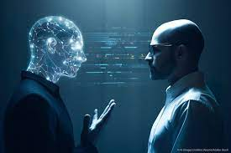
CodeCommandos
Present
Sight Sound Companion
"Where Every Sight Becomes a Symphony and Every Sound
Paints a Picture.”
Team members
Debarghya
Prabhat

Slide 2

PROBLEM STAEMENT
“Develop a platform that leverages advanced AI algorithms to dynamically adapt and personalize learning pathways for students based on their individual learning styles, preferences, and performance data. The solution should enhance engagement, comprehension, and retention, catering to diverse educational needs..”

Slide 3
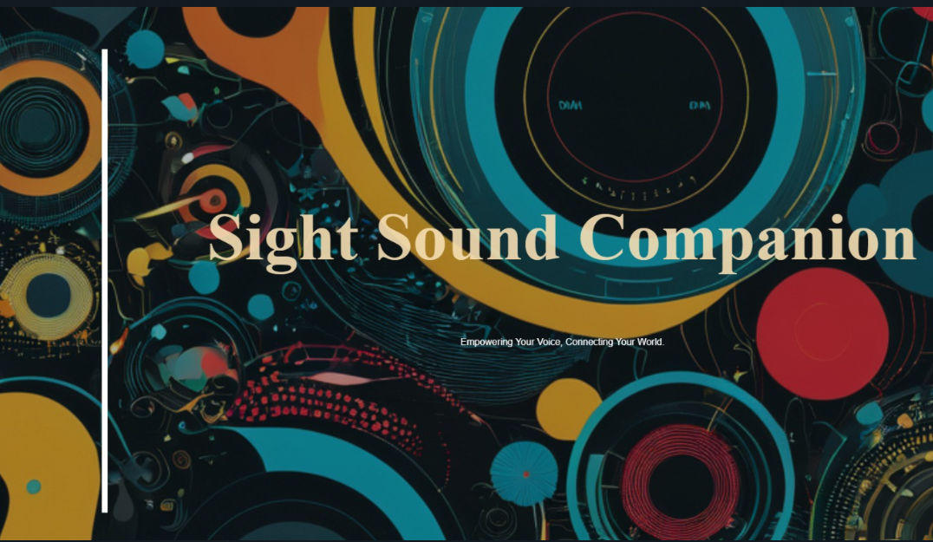
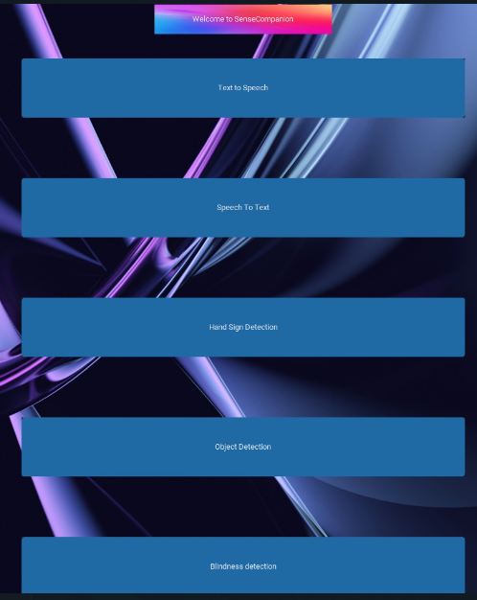

Slide 4





Sight Sound Companion

Slide 5

LIVE SIGN DETECTION

Slide 6

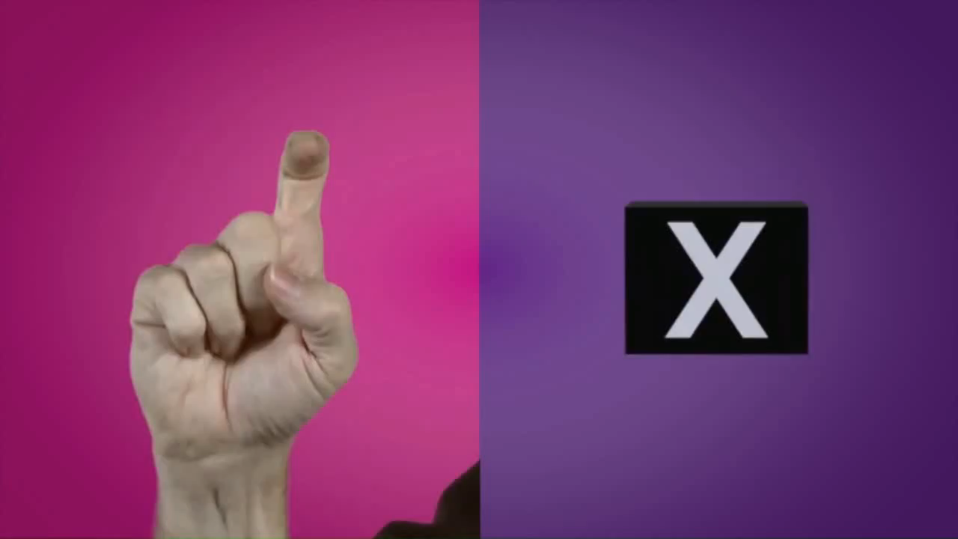
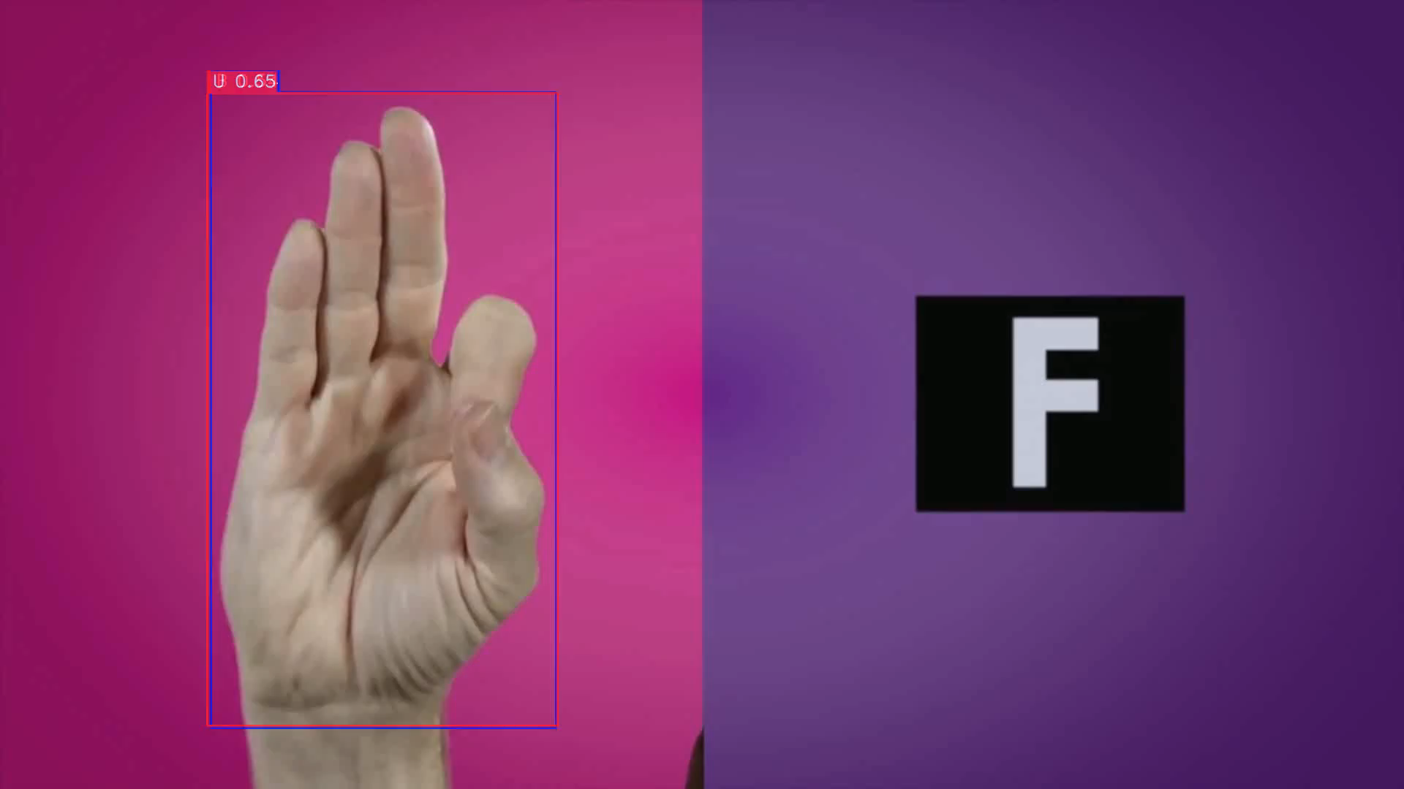
Real Time Sign Language Detection with YOLO-NAS and Webcam Detection Model
Real-Time Detection
Model Architecture
Webcam Detection Model
High Accuracy
Adaptive Learning

Slide 7
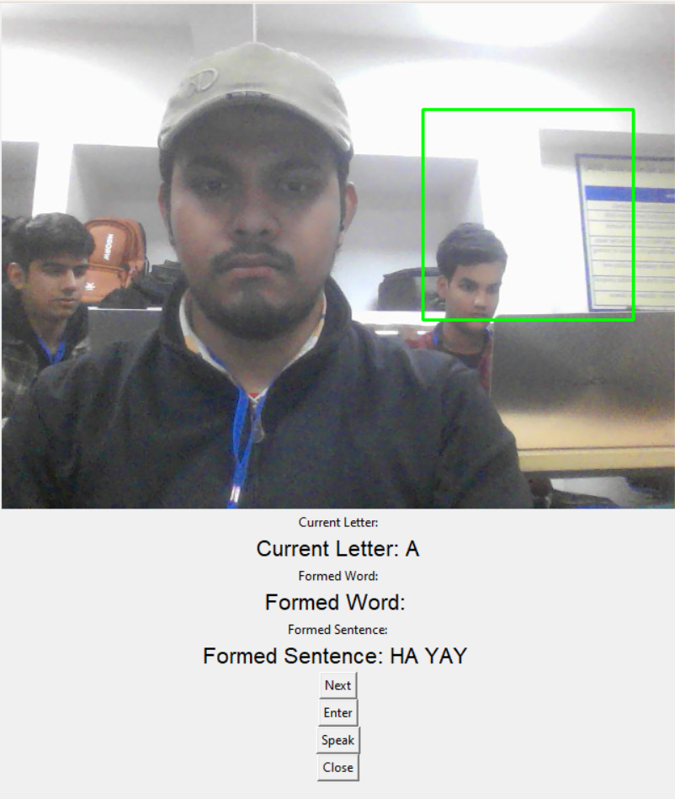
Real Time Sign Language Detection with YOLO-NAS and Webcam Detection Model
Market size
Global Prevalence of Hearing Impairments
Government Initiatives and Regulations
USER
Individuals with Hearing Impairments
Workplaces
USP
Sentence conversion
Speech voice

Slide 8

TEXT TO VOICE

Slide 9


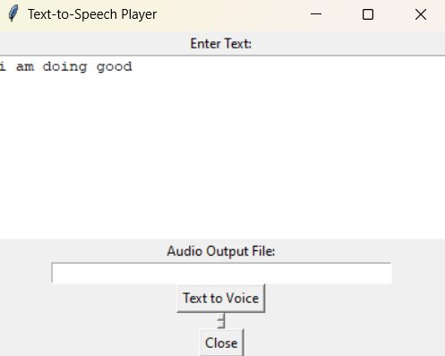
Language
gTTS
Audio file
Market size
AGE FACTOR
Government Initiatives and Regulations
USER
Individuals with Hearing Impairments
Workplaces
USP
Natural and Clear Speech Synthesis
Versatility and Inclusivity

Slide 10

VOICE TO TEXT

Slide 11

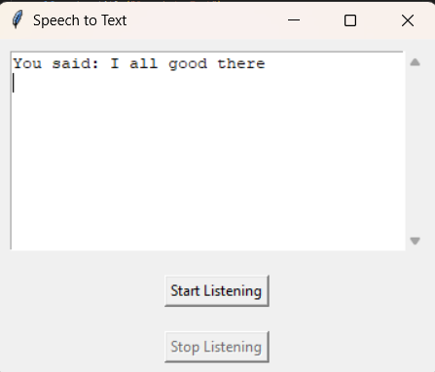
Pydub
AudioSegment
pyttsx3

Slide 12

LIVE OBJECT DETECTION

Slide 13

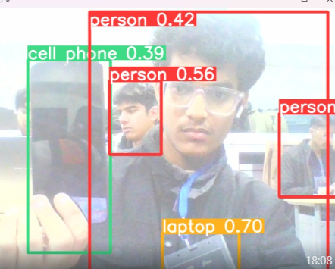
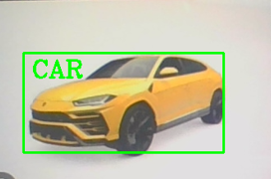
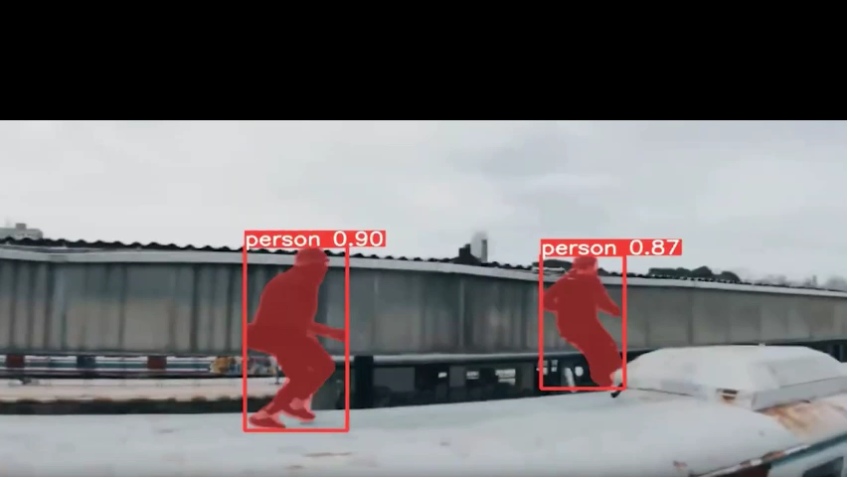

Slide 14

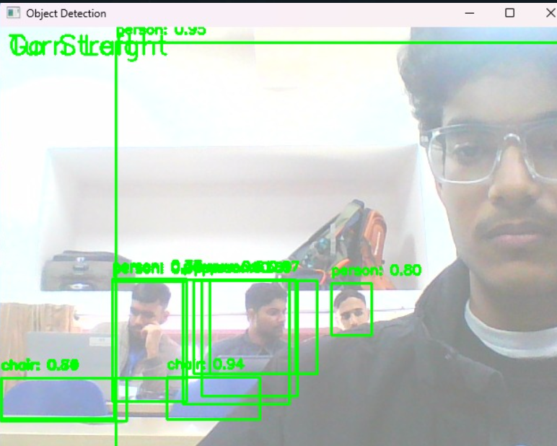
Blind people Navigation system

Slide 15
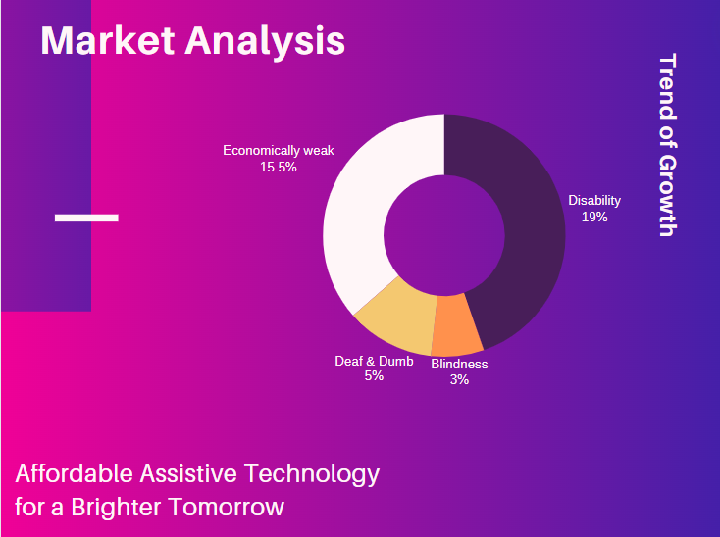
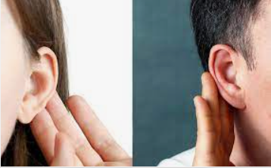
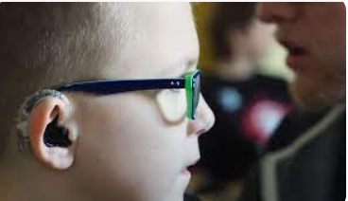

Slide 16

The Unique Selling Proposition (USP)
Dynamic Password Manager Integration
Cross-Domain Integration
Versatile Language Support

Slide 17

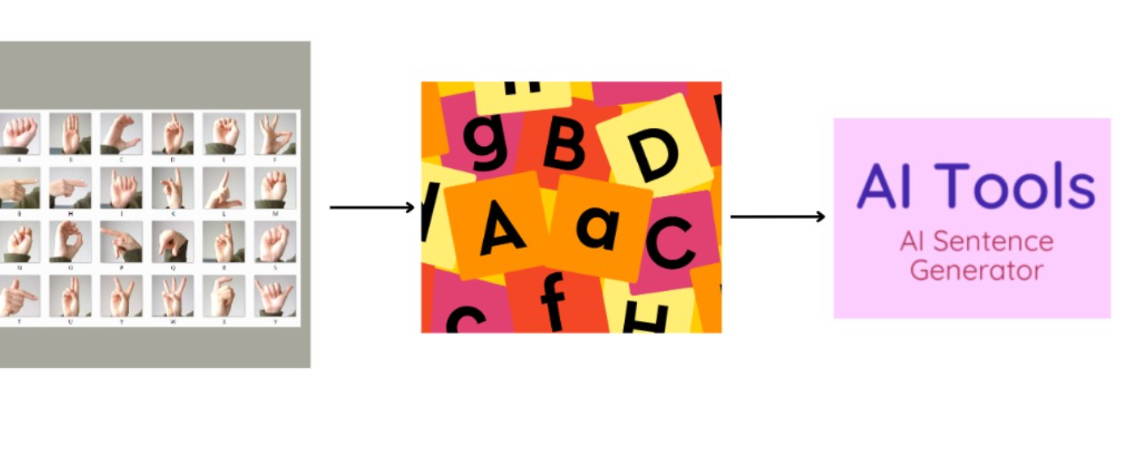
Future
Development
Enhancement
Vibration enhancements
Create a mobile app
Map feature

Slide 18
T
H
A
N
K
Y
O
U

